Slide 1
The Rise of Retrieval-Augmented NLP
Paper: Retrieve-and-Sample: Document-level Event Argument Extraction via Hybrid Retrieval Augmentation
Team 41 Members: Payal Rashinkar, Ashley Taylor, Bhuvan Shah, Sriram Gurazada, Tran Huy Nguyen

Slide 2
Table of Contents
Motivation
Introduction
Methodologies
Experiments
Results
Conclusion

Slide 3
Motivation
Enhancing NLP with Retrieval-Augmentation
Challenges in Document-Level Event Argument Extraction (EAE)
Innovating Retrieval Strategies for Document-Level EAE

Slide 4
Enhancing NLP with Retrieval-Augmentation
Recent studies highlight the effectiveness of retrieval-augmented methods in generative NLP tasks.
Retrieval-augmented techniques enable models to access prior external knowledge in a non-parametric way, enhancing text generation.
These methods rely on similarity-based retrieval, aiming to match the input with relevant prior instances for improved output accuracy.

Slide 5
Challenges in Document-Level Event Argument Extraction (EAE)
Applying retrieval-augmentation in document-level EAE presents unique challenges.
The complexity of event labels and the sparsity of event arguments often undermine the effectiveness of similarity-based retrieval.
This complexity raises a critical question: How can we design a retrieval strategy that effectively supports document-level EAE?

Slide 6
Innovating Retrieval Strategies for Document-Level EAE
Their research investigates various retrieval settings to optimize document-level EAE.
They introduce a novel approach that utilizes pseudo demonstrations from event semantic regions, offering a broader context and schema coverage.
Through extensive experiments on RAMS and WikiEvents, they validate their retrieval-augmented methods, showcasing their effectiveness and providing insights into their success.

Slide 7
2. Introduction
Understanding Document-Level Event Argument Extraction (EAE)
Definition: Document-Level EAE involves extracting informative event kernels from texts, which includes identifying event arguments and their roles within a document.
Importance: Essential for enhancing downstream applications such as information retrieval, question answering, and event graph reasoning.

Slide 8
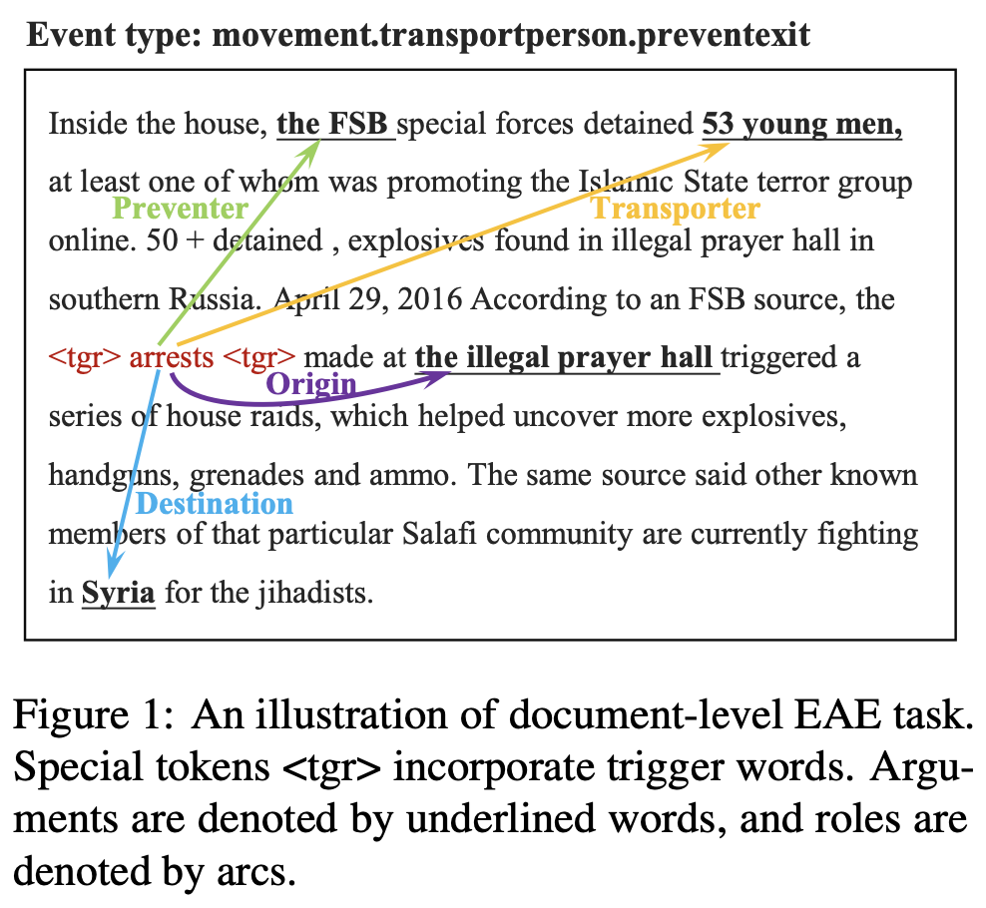
A visual representation of document-level EAE showing the extraction process

Slide 9
Exploration of Retrieval Settings for Document-Level EAE
Introduction of three settings to address the unique challenges of document-level EAE:
Context-Consistency Retrieval: Aims for semantic consistency by retrieving similar contexts.
Schema-Consistency Retrieval: Focuses on retrieving instances with similar event schemas to improve role label accuracy.
Adaptive Hybrid Retrieval: Samples pseudo demonstrations from continuous space for both context and schema consistency.

Slide 10
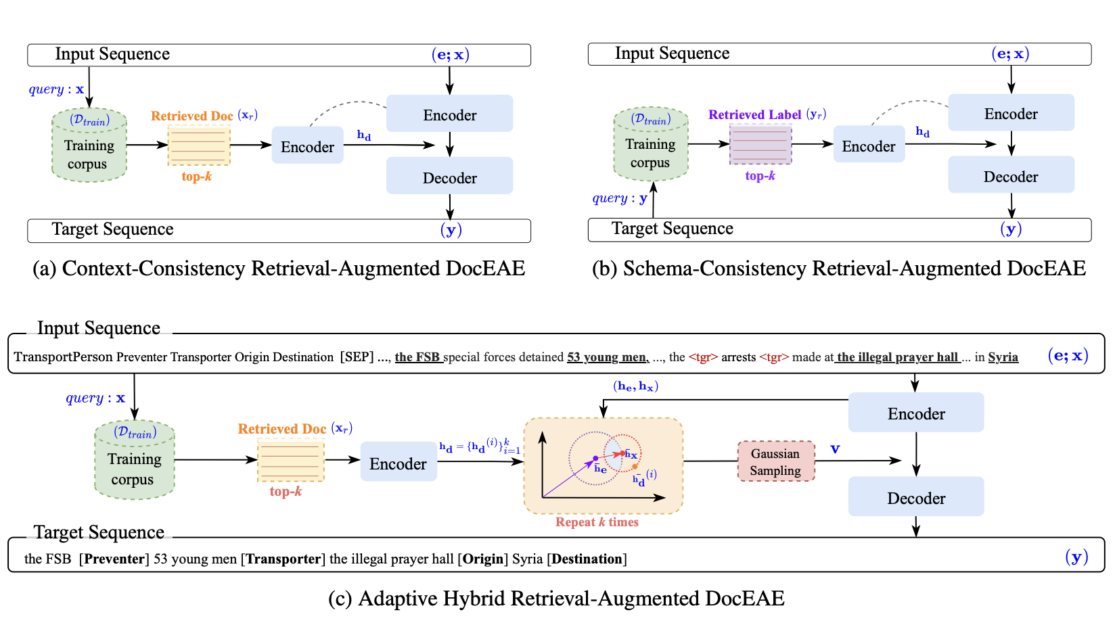
3. Methodology

Slide 11
Enhancing EAE with Gaussian Sampling
Why Gaussian Sampling?
Gaussian sampling would pick points that are not just the existing examples (the documents and schemas) but also new points that lie in the space around them. These new points represent potential new examples that are a mix of the context and schema information.
Beyond Existing Examples: Gaussian sampling goes beyond the fixed points (existing training instances) to explore a broader space of possibilities.
Creating New Instances: It generates new synthetic instances that are informed by, but not identical to, existing examples.
Blending Context and Schema: These new instances are a mix, containing elements of both the contextual and schema information from the training data.
Richer Training Data
Model Generalization

Slide 12
T5 at the Core of RAG for Event Argument Extraction
Mechanics of RAG:
Conditional Probability: The T5 model is leveraged to predict the likelihood of each new word based on the input sequence and the previously generated text.
Input Preparation: The input to the model is a combination of the document's context and the relevant event schema.
Output Generation: The model's output is a sequence that pairs each argument with its corresponding role within the event.
Training and Inference Details:
Trainable Components: Only the encoder-decoder parts of the language model are trained.
Post-Processing: After generation, the model decodes the sequence of roles to match them with their respective arguments for evaluation.

Slide 13
4. Experimental Datasets
Conducted experiments on two widely used document-level EAE datasets:
RAMS: It features a diverse range of events and argument roles. 9,124 annotated examples from news based on 139 event types and 65 argument roles. Its complexity and broad coverage of event types make it ideal for testing the robustness of our method.
WikiEvents: It provides wide array of real-world events extracted from Wikipedia articles. 246 annotated documents based on 50 event types and 59 roles. Its relevance to everyday events and the sparsity of arguments within documents pose a unique challenge, testing the model's ability to generalize and accurately extract arguments in sparse conditions.

Slide 14
Experimental Evaluation Metrics
Metrics for the research are reported as F-1 score of argument identification (Arg-I), argument classification (Arg-C) and for WikiEvents dataset, additionally evaluating argument head F1 score (Head-C).
Arg-I: an event argument is correctly identified if its offsets match those of any of the argument mentions.
Arg-C: an event argument is correctly classified if its offset and role type both match the ground truth.
Head-C: only considers the matching of the headword of an argument.
For the predicted argument, the closest matching string to the golden trigger is identified as the predicted offset. Given that an event type can encompass multiple roles, micro-averaged role-level scores are utilized as the definitive metric.

Slide 15
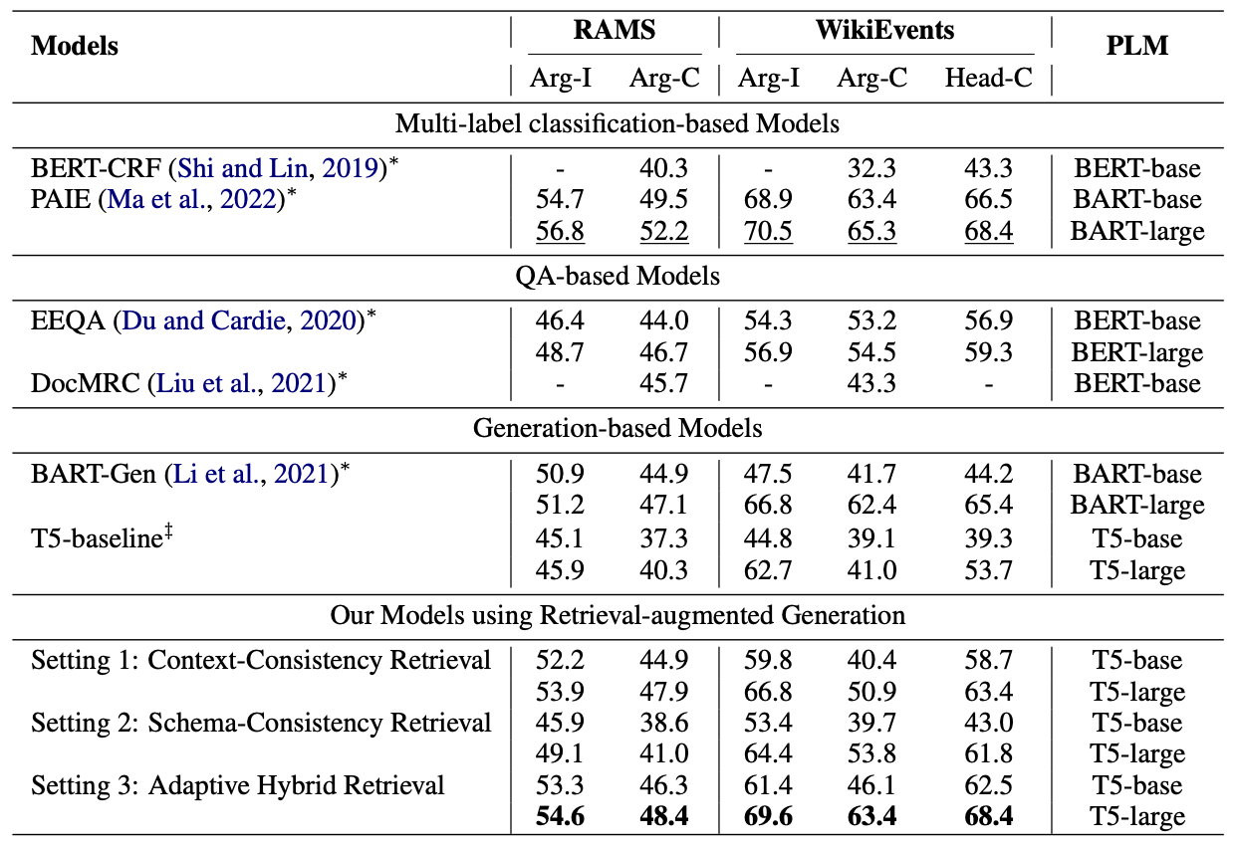

Slide 16
Analysis and Results
By retrieving reference demonstrations to augment text generation, this retrieval-augmented models can significantly outperform generationbased models.
Adaptive Hybrid Retrieval (Setting 3) achieves state-of-the-art performance and improves Arg-C F1 by 1.6%~10.6% and 17.9%~54.6% over the SOTA generation baseline BART-Gen and vanilla T5 on both datasets.
Compared with sequence generation BART-Gen, Our models do not require manually constructing the event template and can directly generate informative role records rather than irrelevant information.

Slide 17
Analysis and Results
By reformulating document-level EAE as retrieval-augmented generation, our models can achieve competitive performance without manually designing specific questions.
By generating pseudo-demonstrations in continuous space as depth cues to guide the model, our Setting 3 inspires the analogical capability of the model more than Setting 1 and 2.

Slide 18
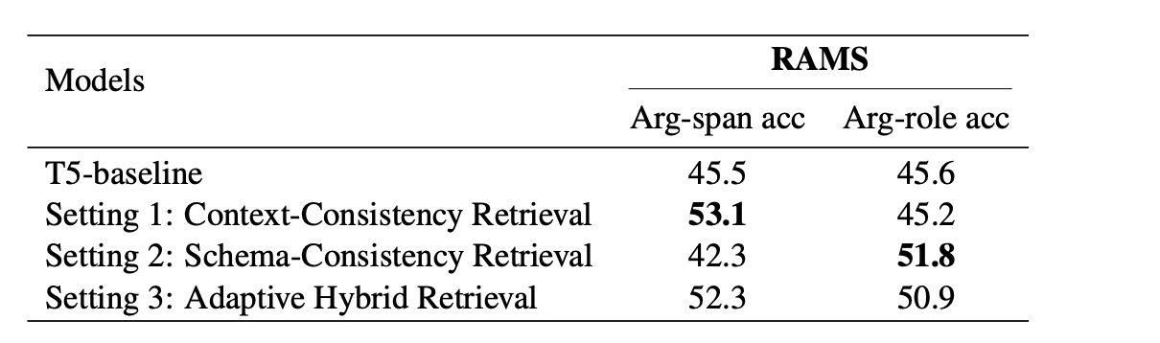
Argument span/role prediction accuracy on RAMS.

Slide 19
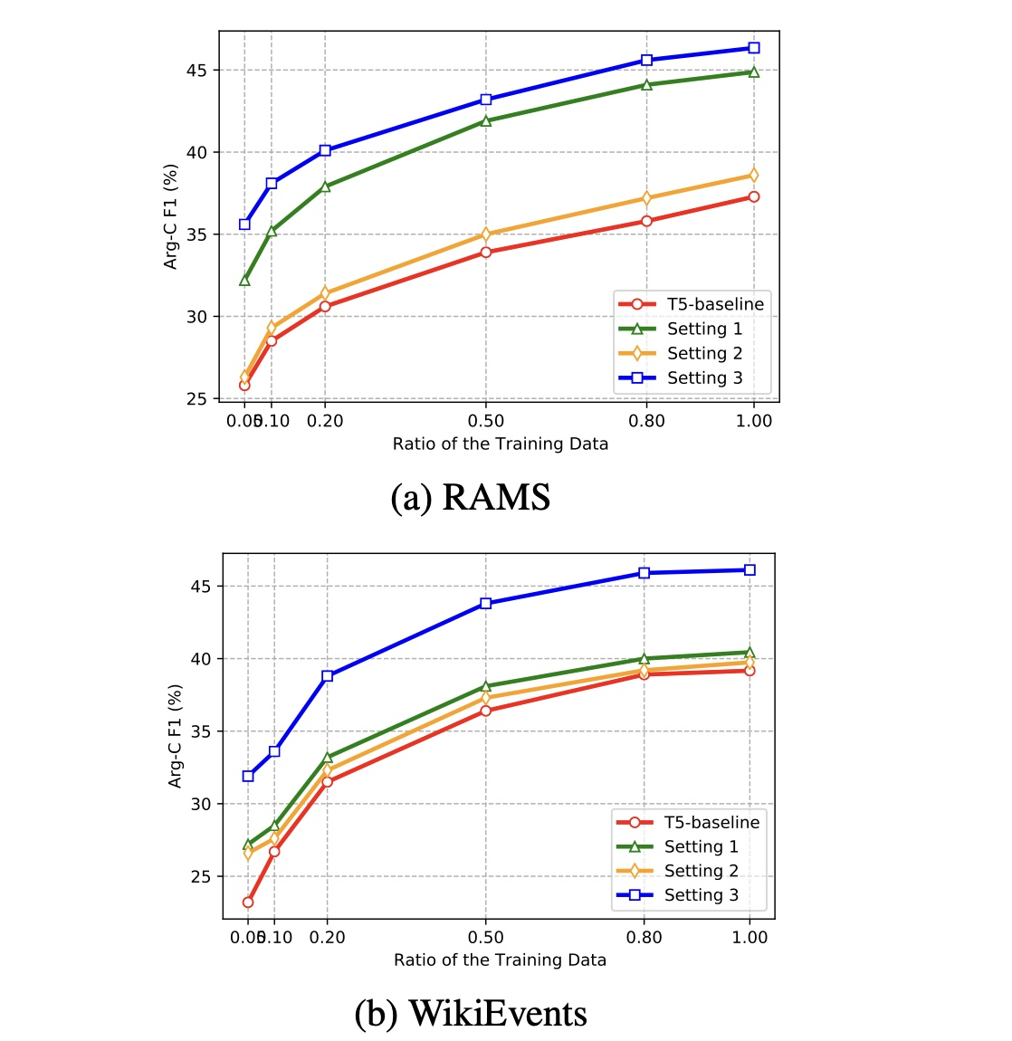
Arg-C F1 scores with different training data ratios on both benchmarks.
It demonstrates our approach achieves comparable performance with the T5- baseline model with only ~20% of training data, which indicates that our approach has great potential to achieve good results with very few data.

Slide 20
Conclusion
Retrieval-augmented models, especially with adaptive hybrid retrieval, significantly enhance document-level EAE.
The approach outperforms traditional generation-based and QA-based models.
Demonstrates the benefit of leveraging external knowledge through retrieval augmentation.

Slide 21
Future Scope
Exploration of retrieval-augmented strategies for other NLP tasks.
Potential adaptation of the approach to different domains and languages.
Optimizing the retrieval process for better efficiency and accuracy.

